Slide 1

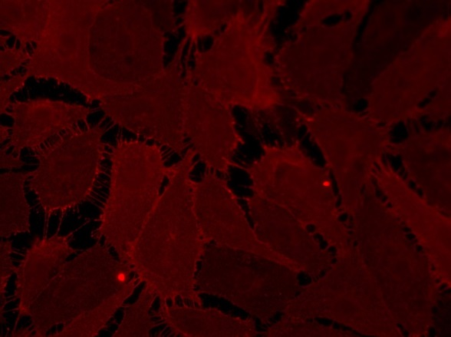
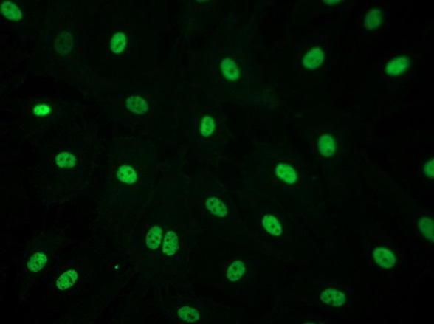
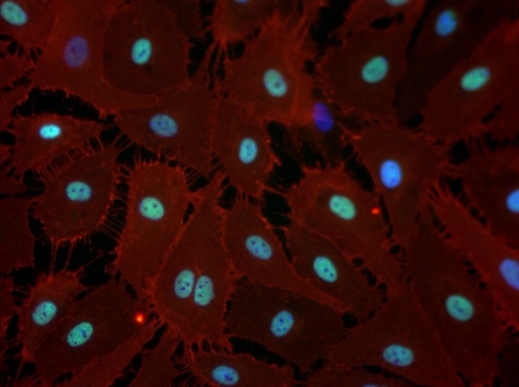
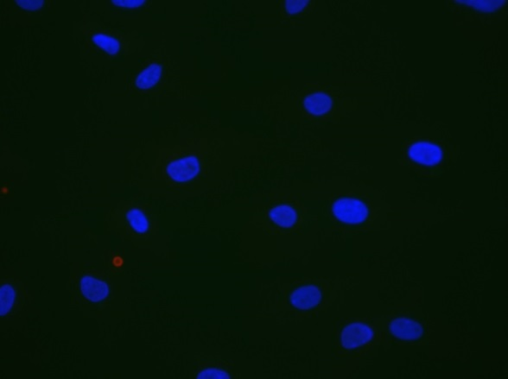
ReliaTech GmbH
Mouse anti-human CD31 #WM-59 / rabbit anti-human Prox1
mouse anti-human CD31
rabbit anti-human Prox1
CD31 / Prox1
Control (goat anti-rabbit IgG ALEXA Flour 488; 1:600
Goat anti-mouse IgG-PE; 1:400))
Immunofluorescence staining of CD31 (red) and Prox1 (green) in primary human dermal lymphatic endothelial cells (HDLEC) with monoclonal mouse anti-human CD31 #WM-59 [Cat# 101-M92] and polyclonal anti-human Prox1 [Cat# 102-PA32AG]. The cells were pretreated wit 0.1% Triton X100.
[IF_LEC1406-04; 102-PA32AG / 101-M92 (5 / 2µg/ml), 400X]
http://www.reliatech.de / info@reliatech.de

